Slide 1



Research Data Management (RDM): Introduction
Sammy Khagayi

Slide 2
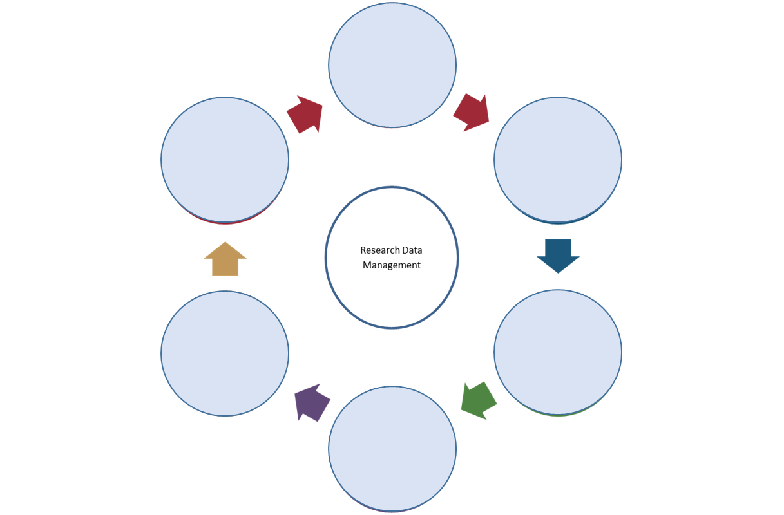
Research data management cycle
Data often has longer lifespan than the research project from which it is derived
Other projects may analyze or add to the data; reused by other researchers
Funders and journal editors are beginning to require that researchers make the underlying data accessible for the long term

Slide 3

Research data management cycle
Before and at start of proposal planning & writing
Conduct a review of existing data sets
Determine if new datasets will be required or combine existing
Investigate archiving challenges, consent and confidentiality
Identify potential users of your data
Look for a suitable archive

Slide 4
Research data management cycle
At the start of the project
Create a data management plan
Make decisions about documentation form and content
Content pretest & tests of materials and methods

Slide 5
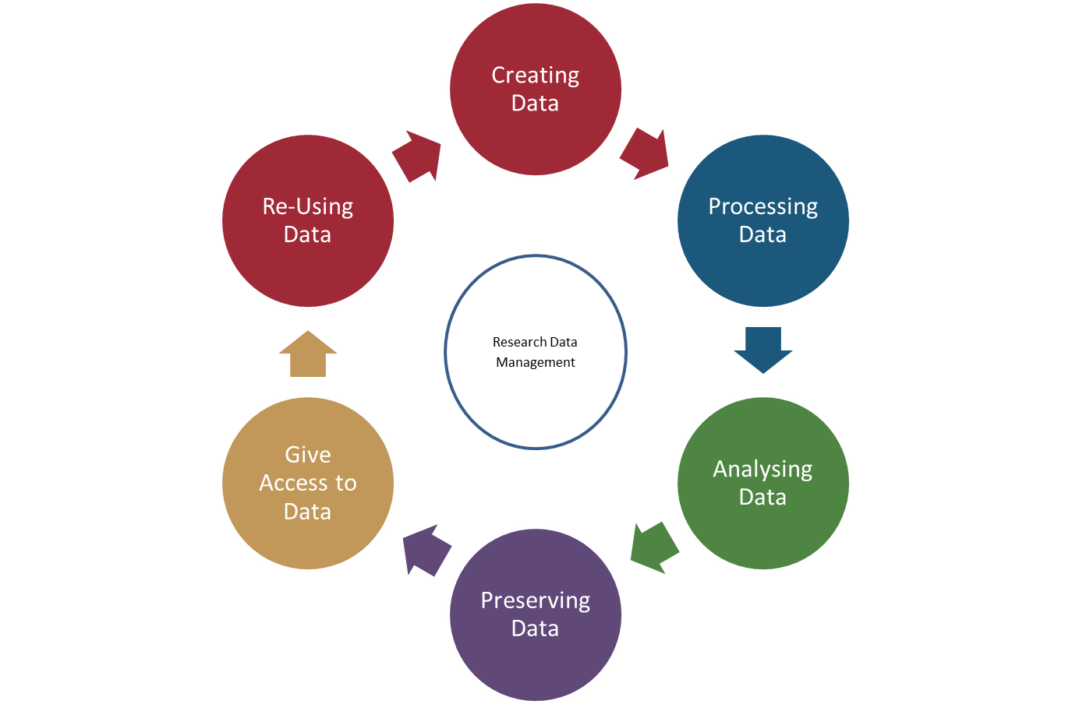
Research data management cycle
Design research (best practices)
Organize files, backups & storage, QA for data collection
Think about access control and security
Ethics – obtaining consent to use or share data
Drawing up collaboration agreements
Locate existing data
Collect data
Capture/create metadata

Slide 6
Research data management cycle
Enter data, transcribe, digitise, translate
Checks, validation, cleaning
Anonymise if necessary
Describe the data
Manage and store

Slide 7
Research data management cycle
Analysing data
Researcher knows best!
IT provide software packages (e.g. Stata, R)
Manage file versions
Interpret data/publish
Document analysis and file manipulations

Slide 8
Research data management cycle
Preparation of data for archive - appropriate format - suitable medium
Back-up and store
Find a suitable repository
Archive data

Slide 9
Research data management cycle
Giving access to data
Catalogue
Data access statements
Access restrictions
Document (more) and clean-up data
Establish copyright
Promote data

Slide 10
Research data management (RDM) cycle
Re-using data
Data sharing agreements
Ownership
Scrutinize findings
Teach/learn
Citation
Follow-up/new research

Slide 11
Acknowledgements

